Slide 1
Classes and Pointers

Slide 2

Example
When a class has a pointer member variable, then it will be used for dynamic memory.
For example
class pointerDataClass
{
private:
int x;
int lenP;
int *p;
};
Consider two objects of above class:

Slide 3

Example
After dynamic memory allocation, the pointer member will refer to the allocated memory

Slide 4
Classes and Pointers
With classes having pointer(s) as member, the class need to provide following functionalities
1. Destructor
2. Assignment Operator Overloading
3. Copy Constructor

Slide 5
1. Destructor
If the following object goes out of scope, what will happen?

Slide 6


2. Assignment Operator Overloading
Given two objects as shown here
If we execute
objectTwo = objectOne;
Show the change to the above diagram

Slide 7
3. Copy Constructor
Syntax to include copy constructor in the definition of a class
className(const className& otherObject);
Copy constructor is called either
When a new object is created with the value of existing object
When a object is passed as a parameter in a function as a pass by value

Slide 8
Linked list
Destructor
Assignment operator
copy constructor

Slide 9
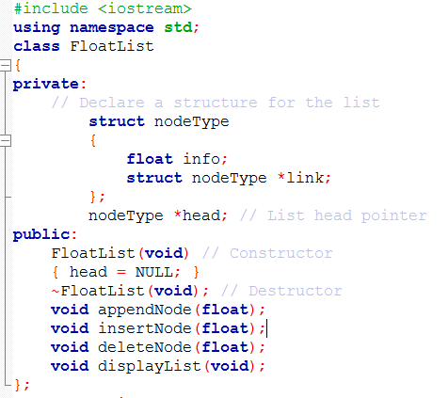
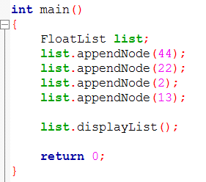
Link List class for storing float values

Slide 10
Important
For classes with pointer member variables, three things are normally included as discussed earlier:
Include the destructor in the class.
Overload the assignment operator for the class.
Include the copy constructor.

Slide 11
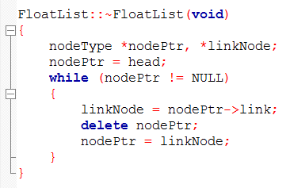
Destructor

Slide 12
Assignment Operation
FloatList list1, list2;
list1.append(20);
list1.append(45);
list1.append(51);
list1.append(76);
list2=list1;
list1
header
20
45
51
76
NULL
list2
header

Slide 13


Assignment Operator Overloading for FloatList class
A
header
20
45
51
76
NULL
B
header
20
45
51
76
NULL
A
header
20
45
51
76
NULL
B
header

Slide 14
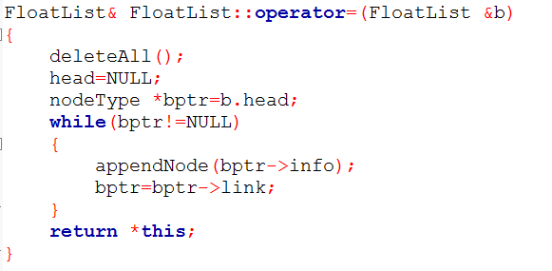
Assignment Operator Overloading

Slide 15
Copy Constructor
A class with dynamic memory allocation also needs a copy constructor in scenarios, where a class object has to be used as a parameter in some function.
The copy constructor automatically executes in three situations (the first two were
described previously as well).
• When an object is declared and initialized by using the value of another object
• When, as a parameter, an object is passed by value
• When the return value of a function is an object

Slide 16
New object creation using existing object
FloatList listA;
//assuming list has been populated with some values
FloatList listB( listA );
//this is a call to a copy constructor, which should populate listB with same values as of listA

Slide 17
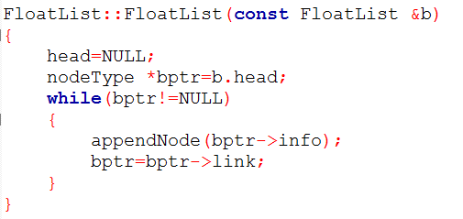
Copy Constructor

Slide 18
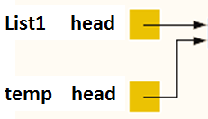
floatList object passed as value
FloatList list1;
//assuming list1 have some values
xFunc(list1);
Again through default member wise copy, temp head will get list1 head address, thus rather having its own nodes, temp will point to the nodes of list1.
void xFunc(FloatList temp) {
. . . .
}

Slide 19
Object as Return Value
Assuming some FunX
FloatList FuncX( )
{
. . . .
}
//now calling the function
FloatList listA = FunX( );

